Slide 1






KIcKSTARTERS CROWDFUNDING ANALYSIS
CROWDFUNDING ANALYSIS THROUGH 4 DIFFERENT TOOLS
  Excel
  Power Bi
  Tableau
  MySQL Queries
Group-2 : Anadi, Srushti, Bhavani, Vijay, Shyam, Suyash, Chandramouli

Slide 2
PROJECT OVERVIEW
Objective:
  Analyze Kickstarter dataset to uncover insights on crowdfunding campaigns.
  Present findings with interactive visualizations.
Dataset Overview:
Size: 365,892 records, 25+ attributes.
Columns with 25+ attributes (id, name, goal, pledged, category, backers, dates…).
Challenges in Raw Data:
    Inconsistent headers & duplicates.
    Currency variations (USD, GBP, EUR, etc.).
    Different date formats (epoch, dd-mm-yyyy).
    Large file size (365k rows).
Visual: Flow diagram showing Data → Cleaning → Analysis → Visualization → Insights
Tools Used: Excel, Power BI, Tableau, MySQL

Slide 3
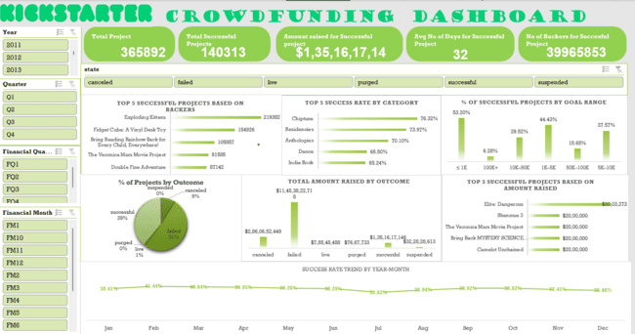
EXCEL DASHBOARD
The Excel dashboard provided a succession-focused view of the dataset, allowing us to directly compare successful and unsuccessful projects across multiple dimensions such as category, country, backer count, and funding goal. This helped us uncover patterns in success rates and highlight the critical role of goal-setting and audience engagement.

Slide 4
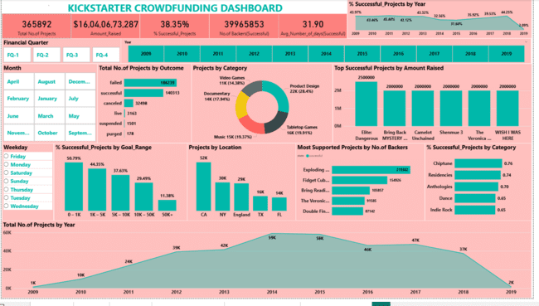
POWERBI DASHBOARD
The Power BI dashboard provided an all-around view of the crowdfunding ecosystem. It combined insights on success rates, country and category comparisons, backer participation, and funding efficiency into a single interactive experience. This helped identify not just whether projects succeeded, but where they succeeded, why they succeeded, and what patterns contributed most to success.

Slide 5
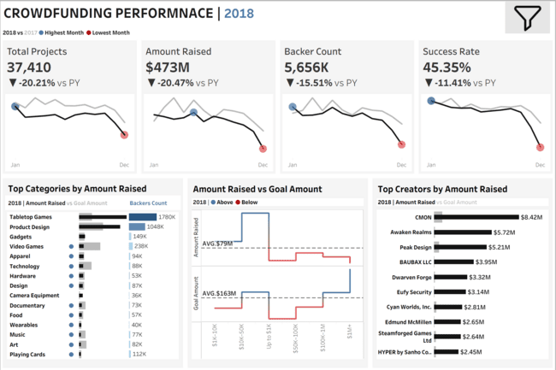
TABLEAU DASHBOARD
The Tableau dashboard revealed how crowdfunding evolved year by year. It not only highlighted the success percentage of projects but also compared ,whether campaigns became more ambitious or conservative over time. The timeline analysis allowed us to see peaks of activity, growth in backer participation, and shifting category dominance, giving a dynamic picture of crowdfunding’s trajectory.

Slide 6
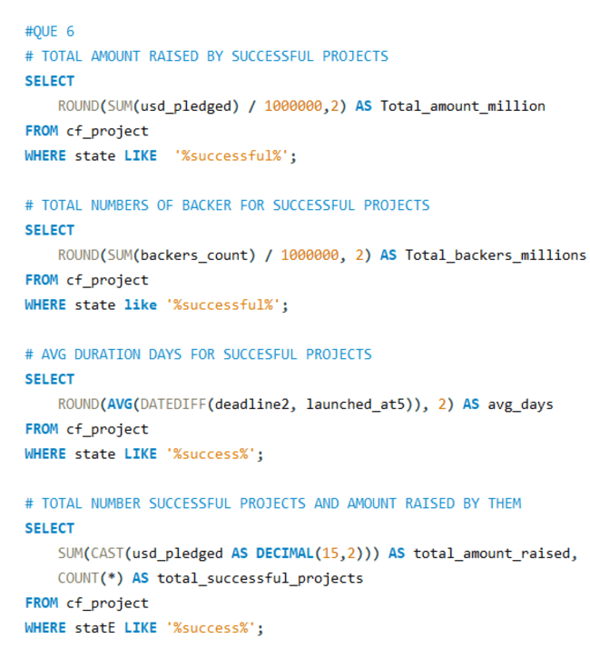
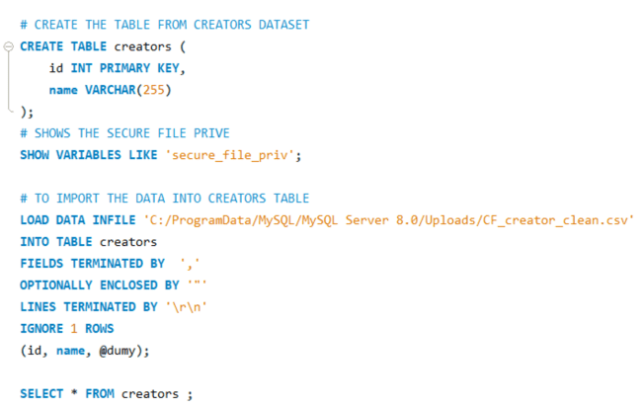
SQL QUERIES
Data Ingestion and Data Analysis MYSQL queries sample

Slide 7


CHALLENGES:
Large Data Volume
  Dataset contained hundreds of thousands of rows, too large for manual handling.
  Excel and direct imports struggled; had to design scalable ingestion methods.
Data Loading into MySQL
  Faced multiple technical errors:
  Row truncation errors due to mismatched column counts.
  Incorrect decimal value errors (currency symbols inside numeric columns).
  Date parsing errors because of mixed formats.
Different Tool Requirements
  Each tool (Excel, Power BI, Tableau, MySQL) had its own limitations and formatting needs.
  Had to repeatedly adapt and restructure the dataset to fit Excel pivot models, Tableau extracts, and Power BI model relationships.
Time-Intensive Cleaning
  Cleaning and standardizing the dataset (especially for dates, goals, pledged amounts, and backers) took more time than analysis.
  Learned the importance of data preprocessing before visualization.
Overcoming these challenges gave me hands-on experience in real-world data handling — from ETL pipelines and SQL staging to visualization adjustments across multiple BI tools.

Slide 8

LEARNINGS
Gained hands-on experience in handling real-world data, building insights-driven dashboards, and deriving actionable business recommendations.
Data Cleaning & Preprocessing:
  Mastered Power Query for handling messy datasets
  Learned to transform headers, remove duplicates, and standardize formats
Database Management & SQL:
  Efficient handling of large datasets in MySQL
  Writing complex queries to generate metrics and insights
Data Visualization & Storytelling:
  Built interactive dashboards in Tableau and Power BI
  Learned to select the right charts for trends, comparisons, and KPIs
Analytical Thinking & Insights Generation:
  Identified success patterns across categories, goal ranges, and campaign durations
  Converted raw data into actionable recommendations for stakeholders
Project Management Skills:
  Executed end-to-end workflow: Raw Data → Cleaned Data → SQL Analysis → Dashboards → Insights
  Learned importance of structured documentation and effective presentation

Slide 9


BUSINNESS SOLUTIONS
Transforming data insights into actionable business strategies for crowdfunding campaign optimization.
Maximize Campaign Success Rate:
Focusing on high-performing categories
launching campaigns in categories with historically higher success rates
Set Optimal Funding Goals
goal-range analysis to set realistic funding targets
Avoid extremely high or low goals to improve backer engagement
Time Campaign Launch Strategically

Slide 10
THANK
YOU …
Group-2: Anadi, Srushti, Bhavani, Vijay, Shyam, Suyash, Chandramouli

